Slide 1
Stuck Liver Qi/Blood revisited
Modern lifestyle issues:
A simple case of more magnesium needed ?

Slide 2
Liver Qi needs to flow
Affects digestion – all aspects
Circulation (esp to head/eyes/genitals)
Reproduction (Liver Blood)
Nervous - how we feel
QI and Blood flowing = no pain
Qi & Blood transformation/transportation - normal reproduction/’hormones’

Slide 3
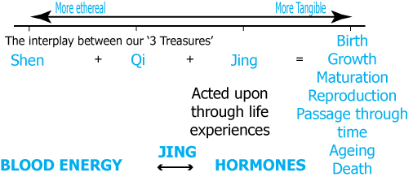
3 Treasures

Slide 4
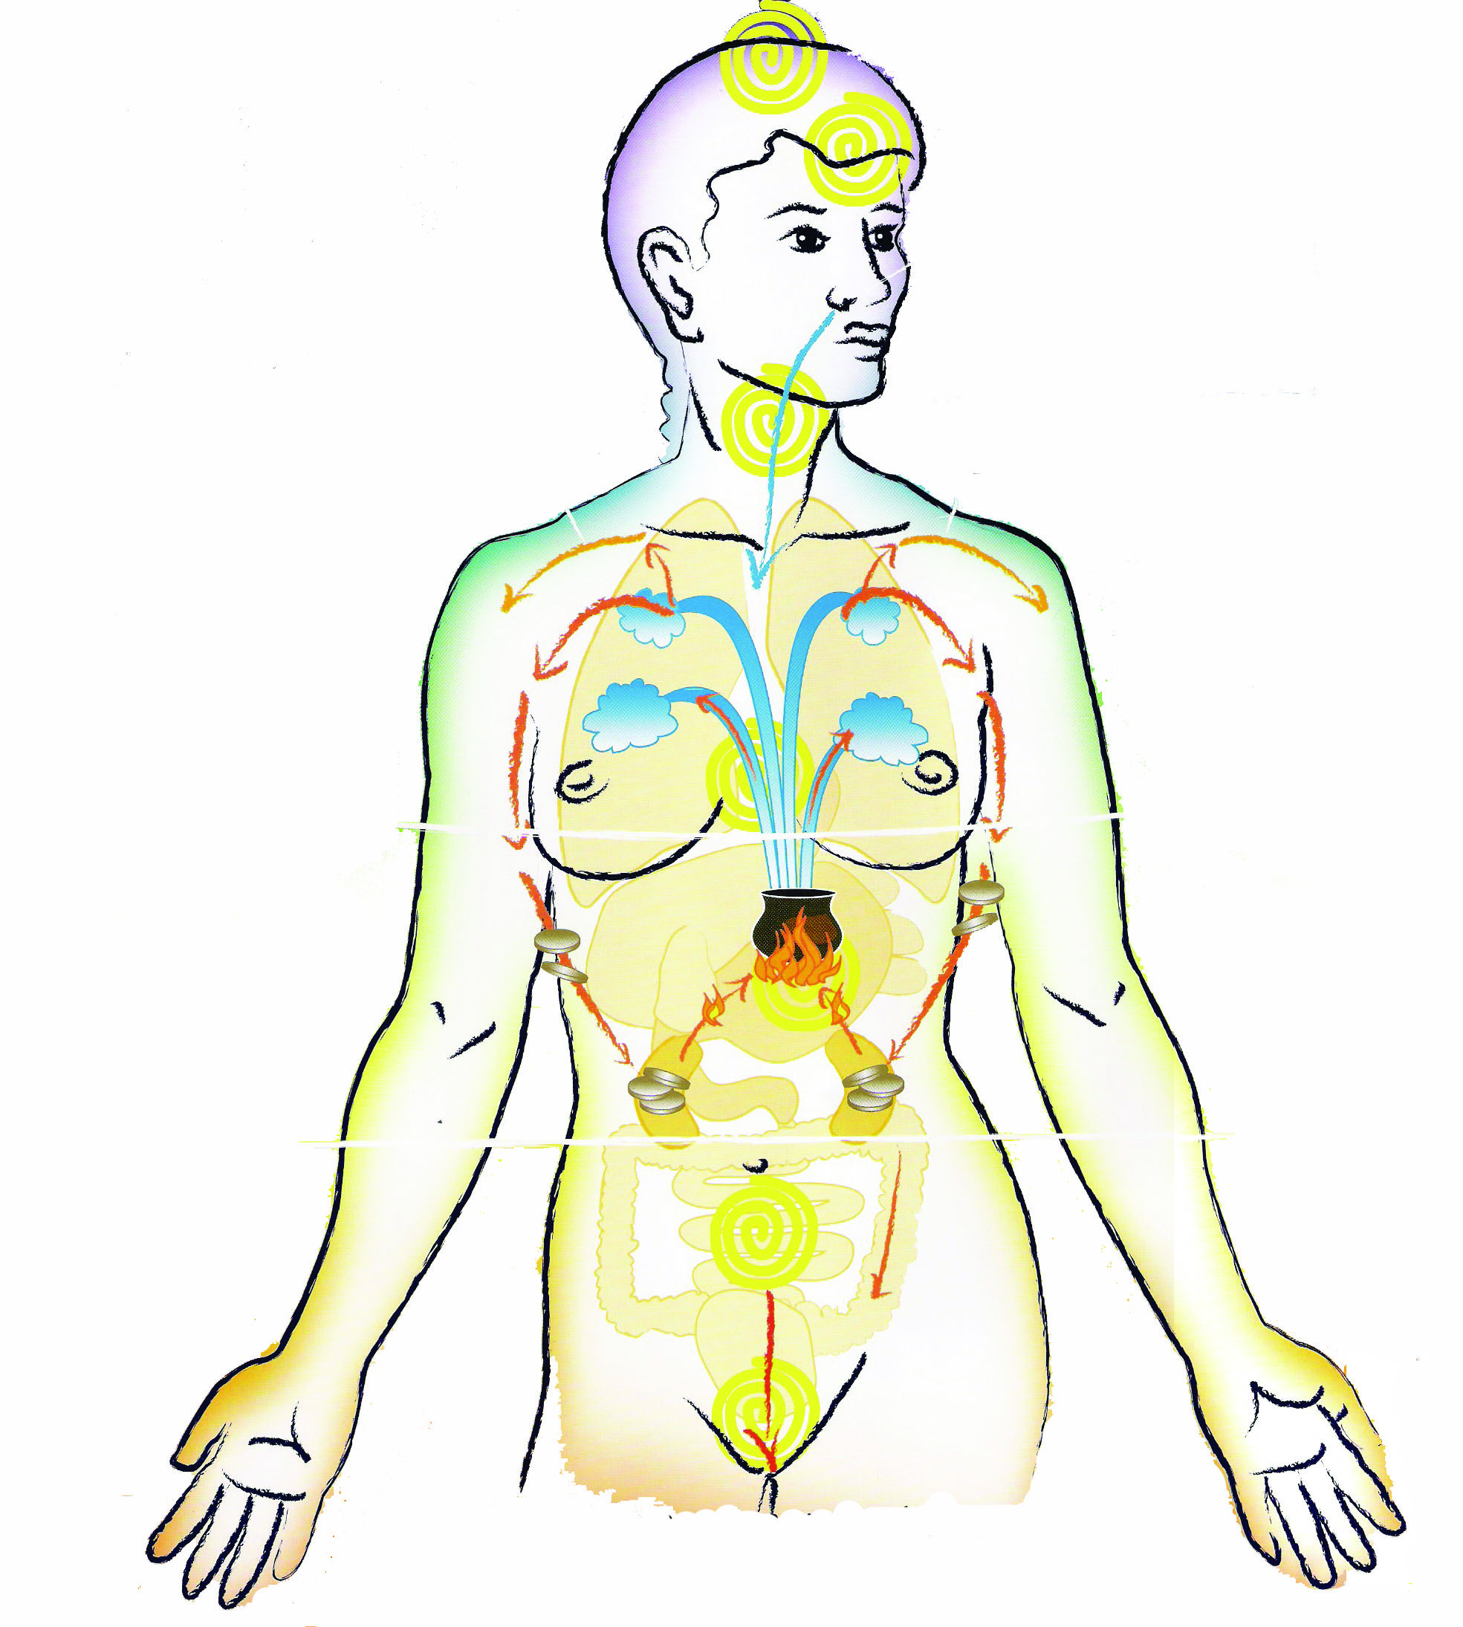
Three heater model

Slide 5
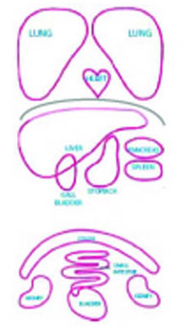
Acupuncture (TCM ) model

Slide 6
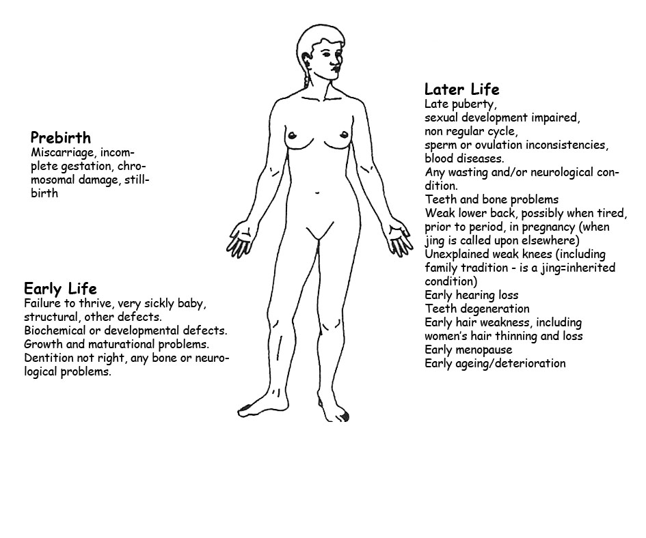
Jing - how it unfolds

Slide 7
How Jing manifests

Slide 8
The ages of women

Slide 9
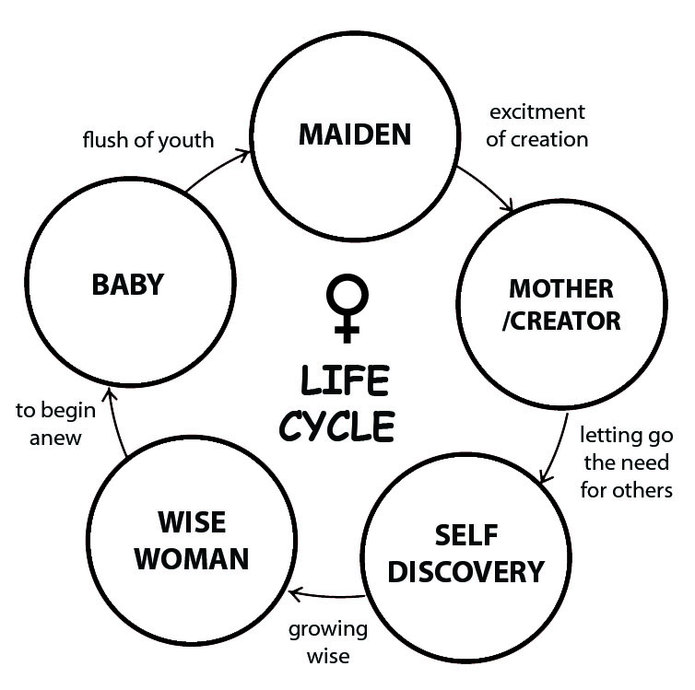
The ages of women

Slide 10
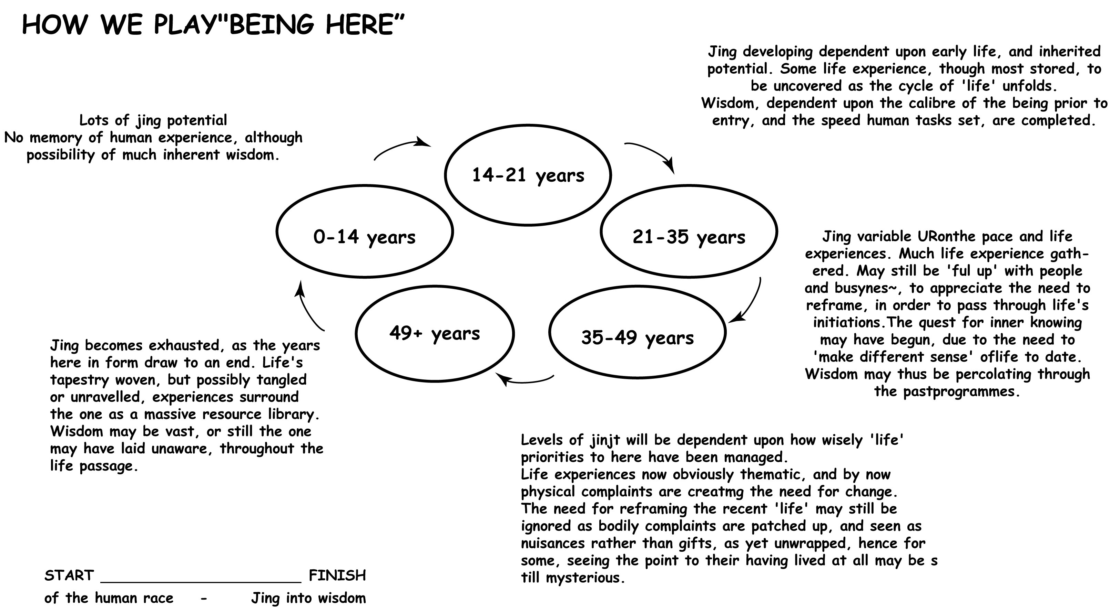

Slide 11
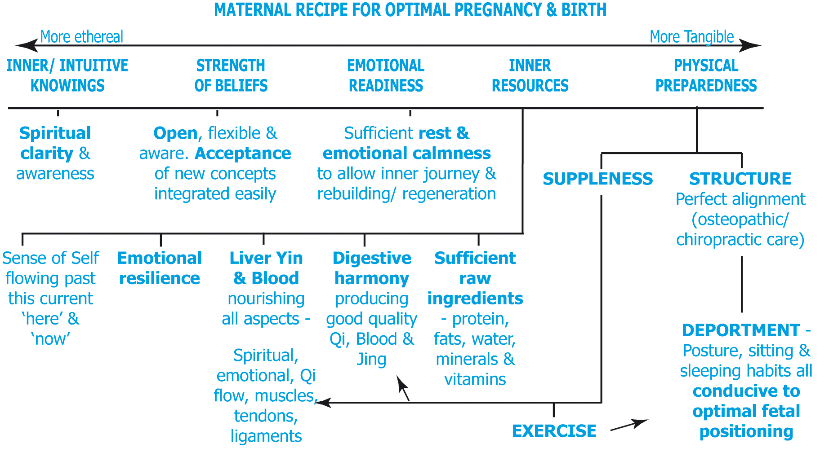
Emotions in Health

Slide 12
Bao Mai – uterus nourishing

Slide 13
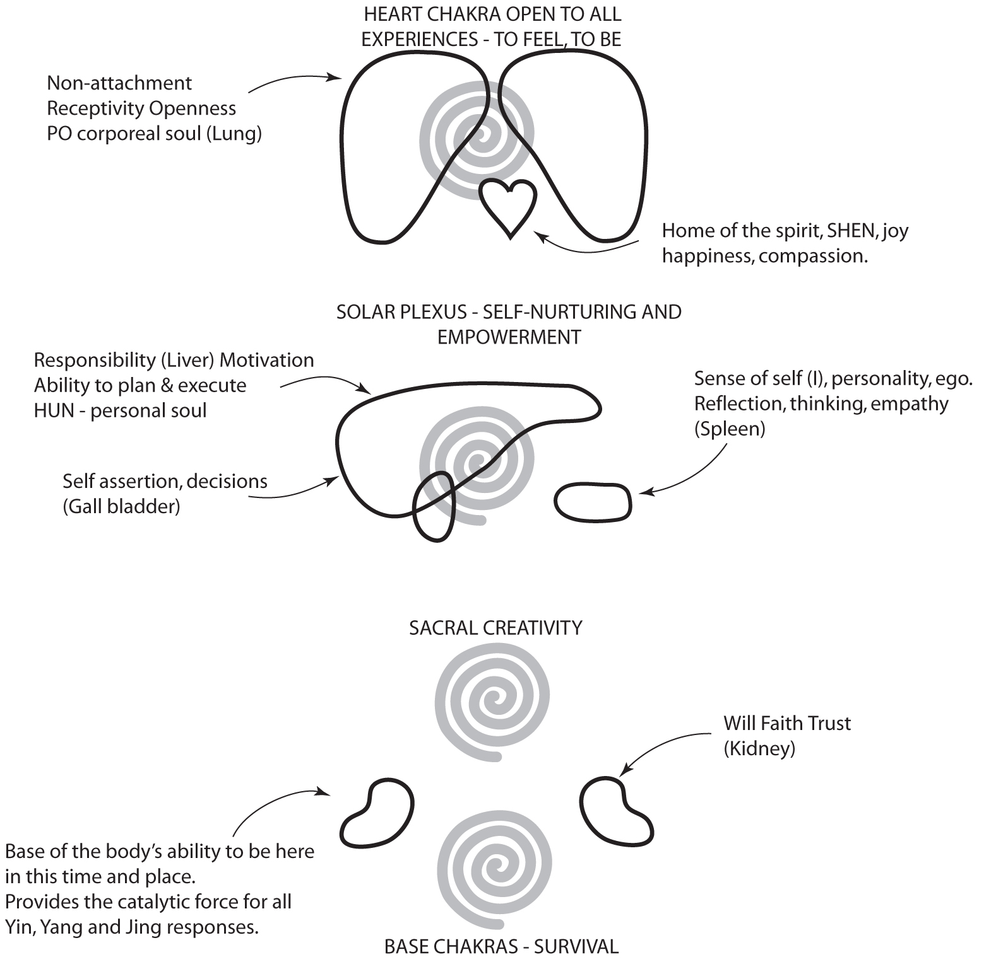

Slide 14
Calm peaceful Liver Qi

Slide 15
Liver Qi in balance – life is easy

Slide 16
How to help ourselves

Slide 17
Good Blood Energy

Slide 18
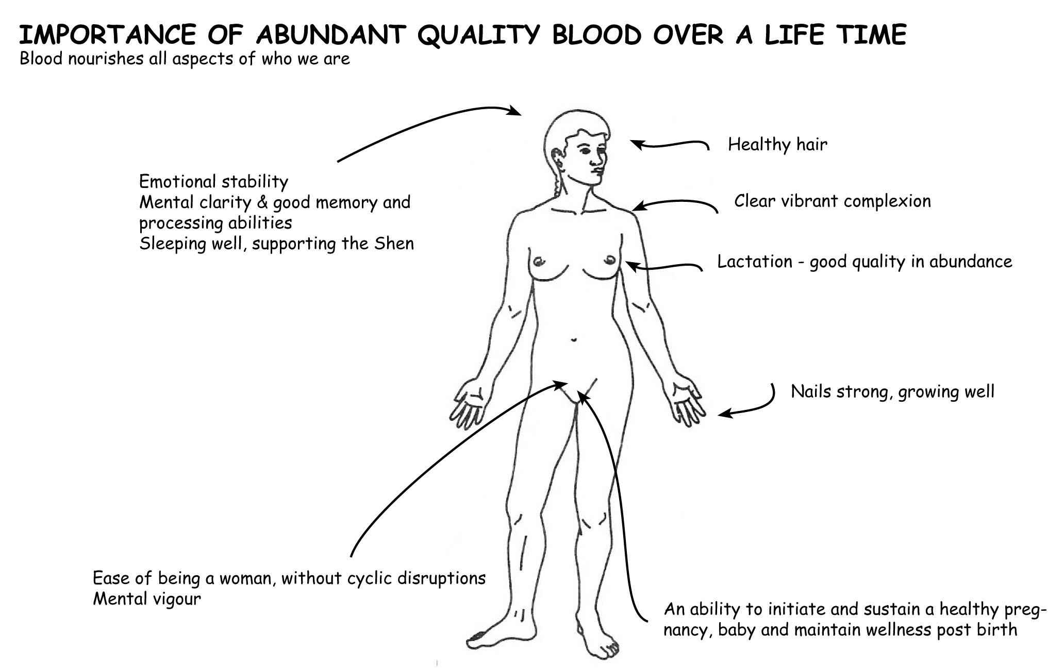
Blood in a Woman’s life

Slide 19
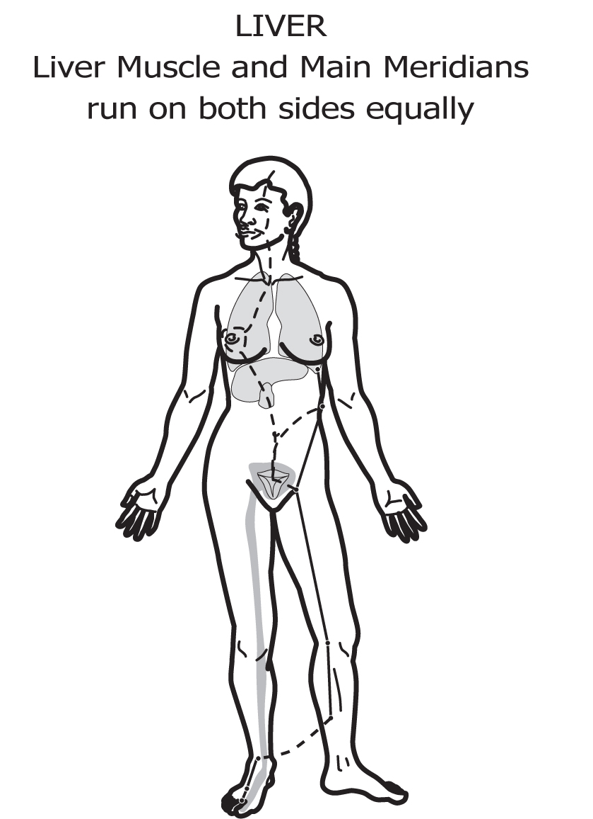

Slide 20
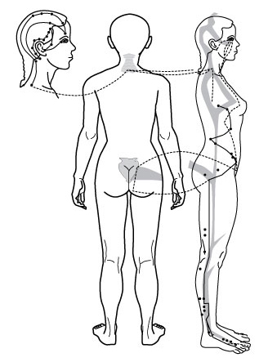

Slide 21

Head in detail – GB meridian

Slide 22
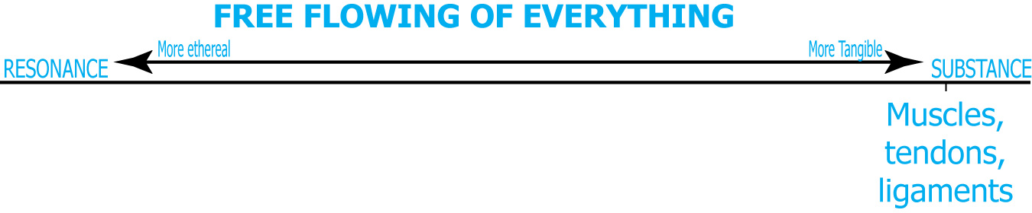
Liver Qi flow - structural

Slide 23
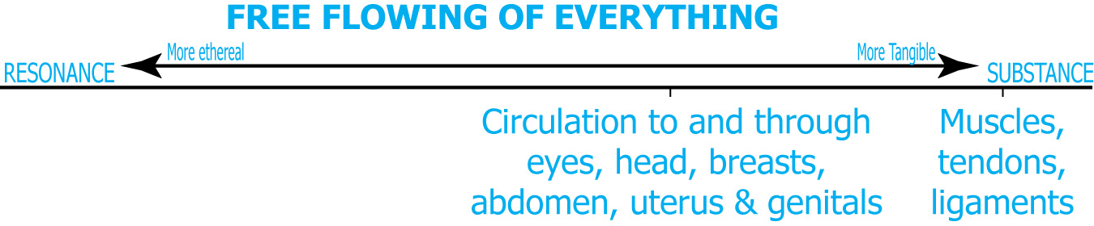
Liver Qi flow to body

Slide 24
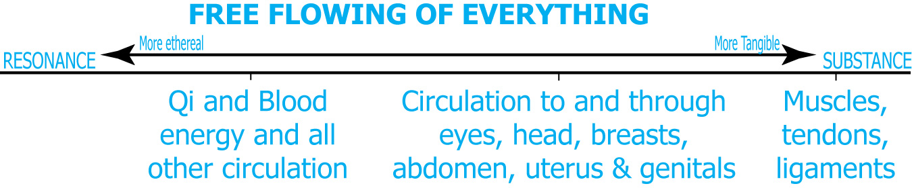
Energy flows

Slide 25
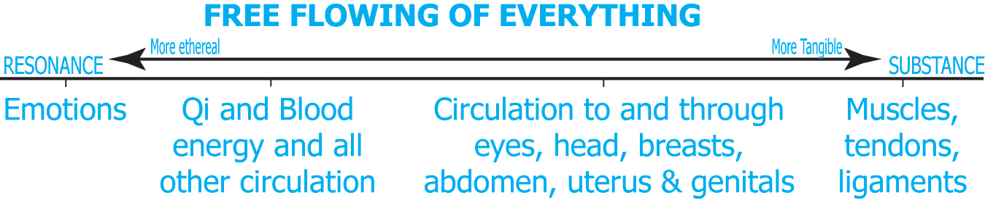
Liver QI flow - emotions

Slide 26
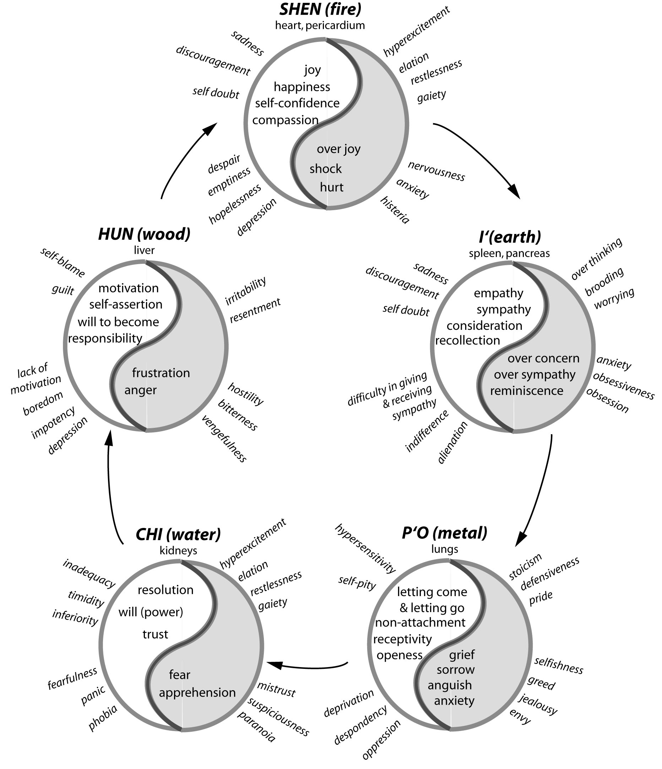
‘Emotional Kaleidoscope’ -‘Joy of Feeling’ Iona Marsaa Teeguarden

Slide 27
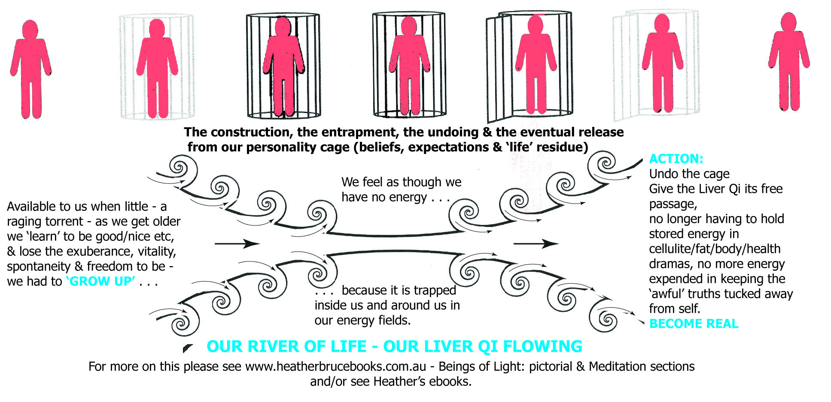
How we get shut down by culture

Slide 28
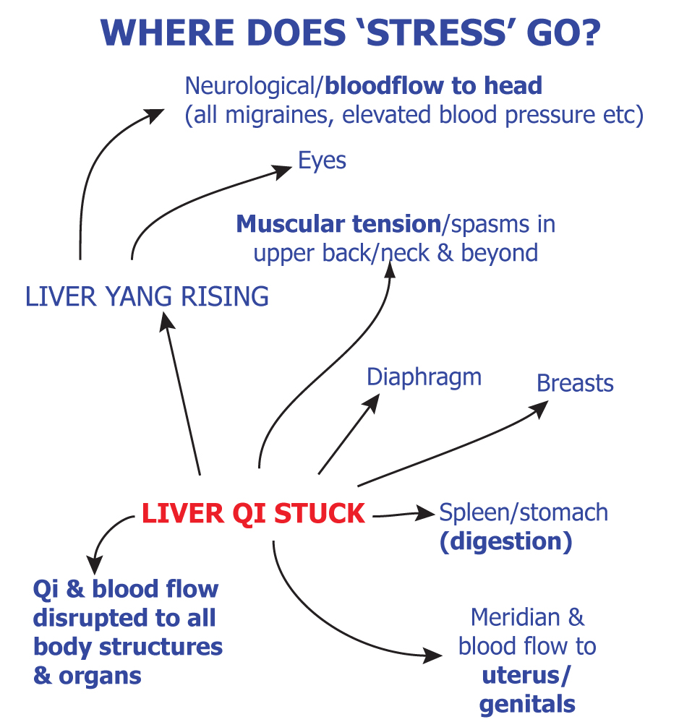
Stress = Stuck Liver Qi .. . .

Slide 29
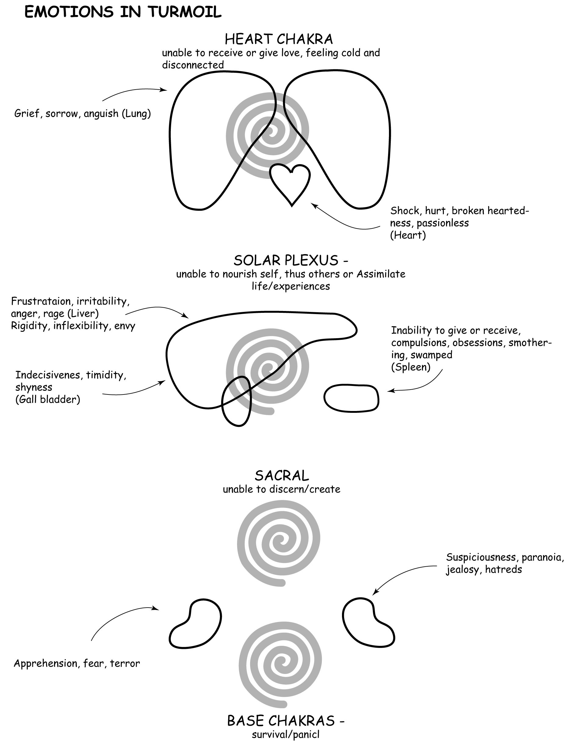

Slide 30
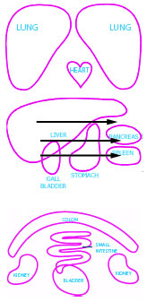
Liver Qi may invade Stomach

Slide 31
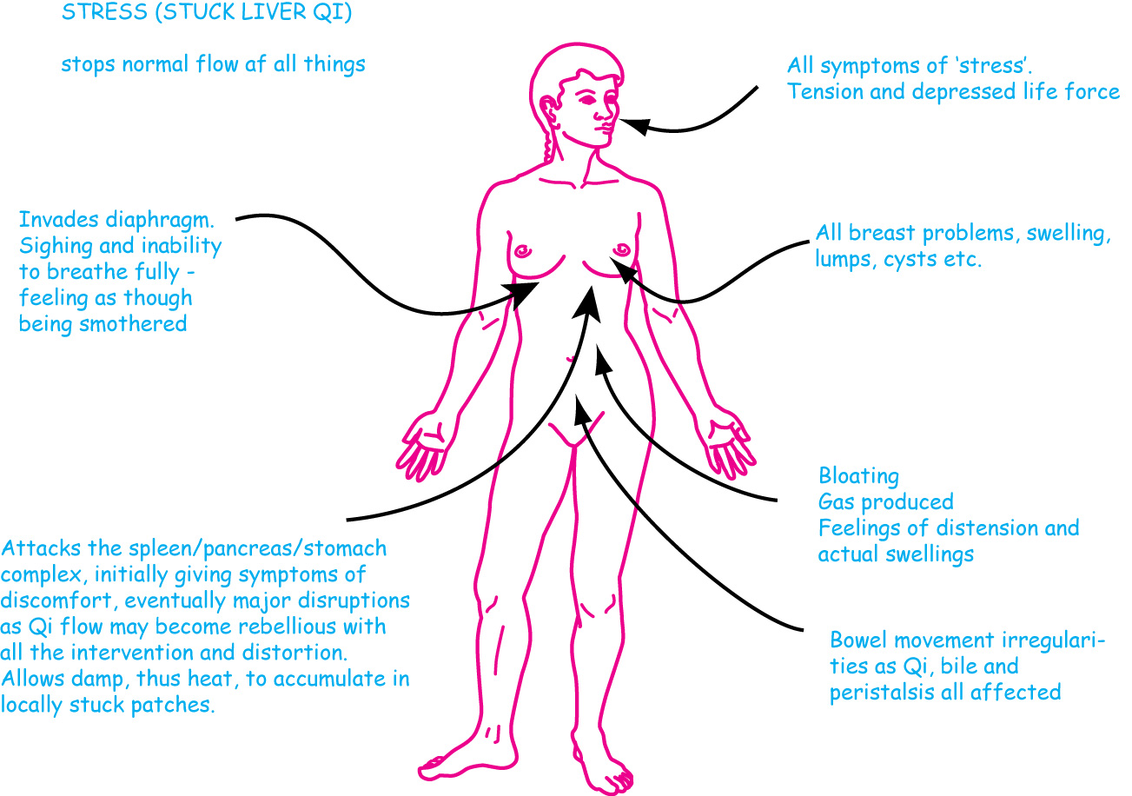
Where/how? – Stuck Liver Qi

Slide 32
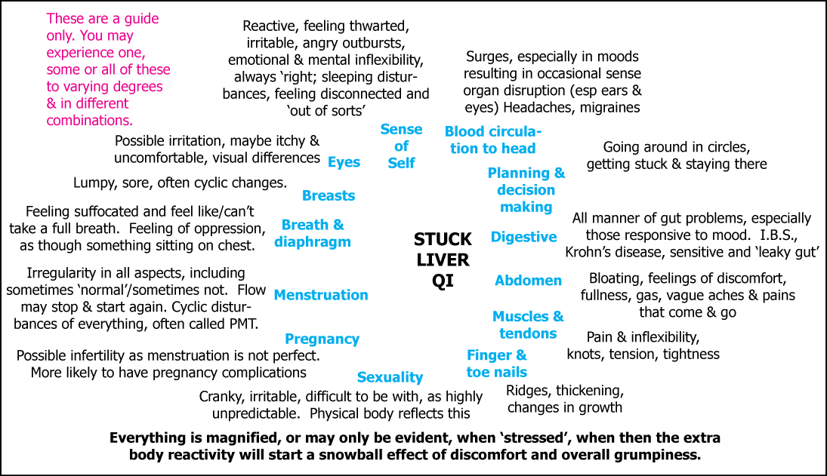
When things get congested

Slide 33
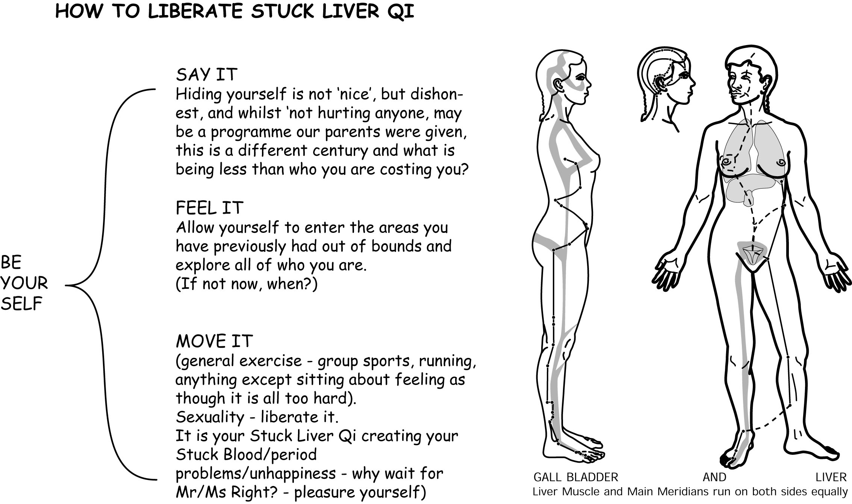

Slide 34
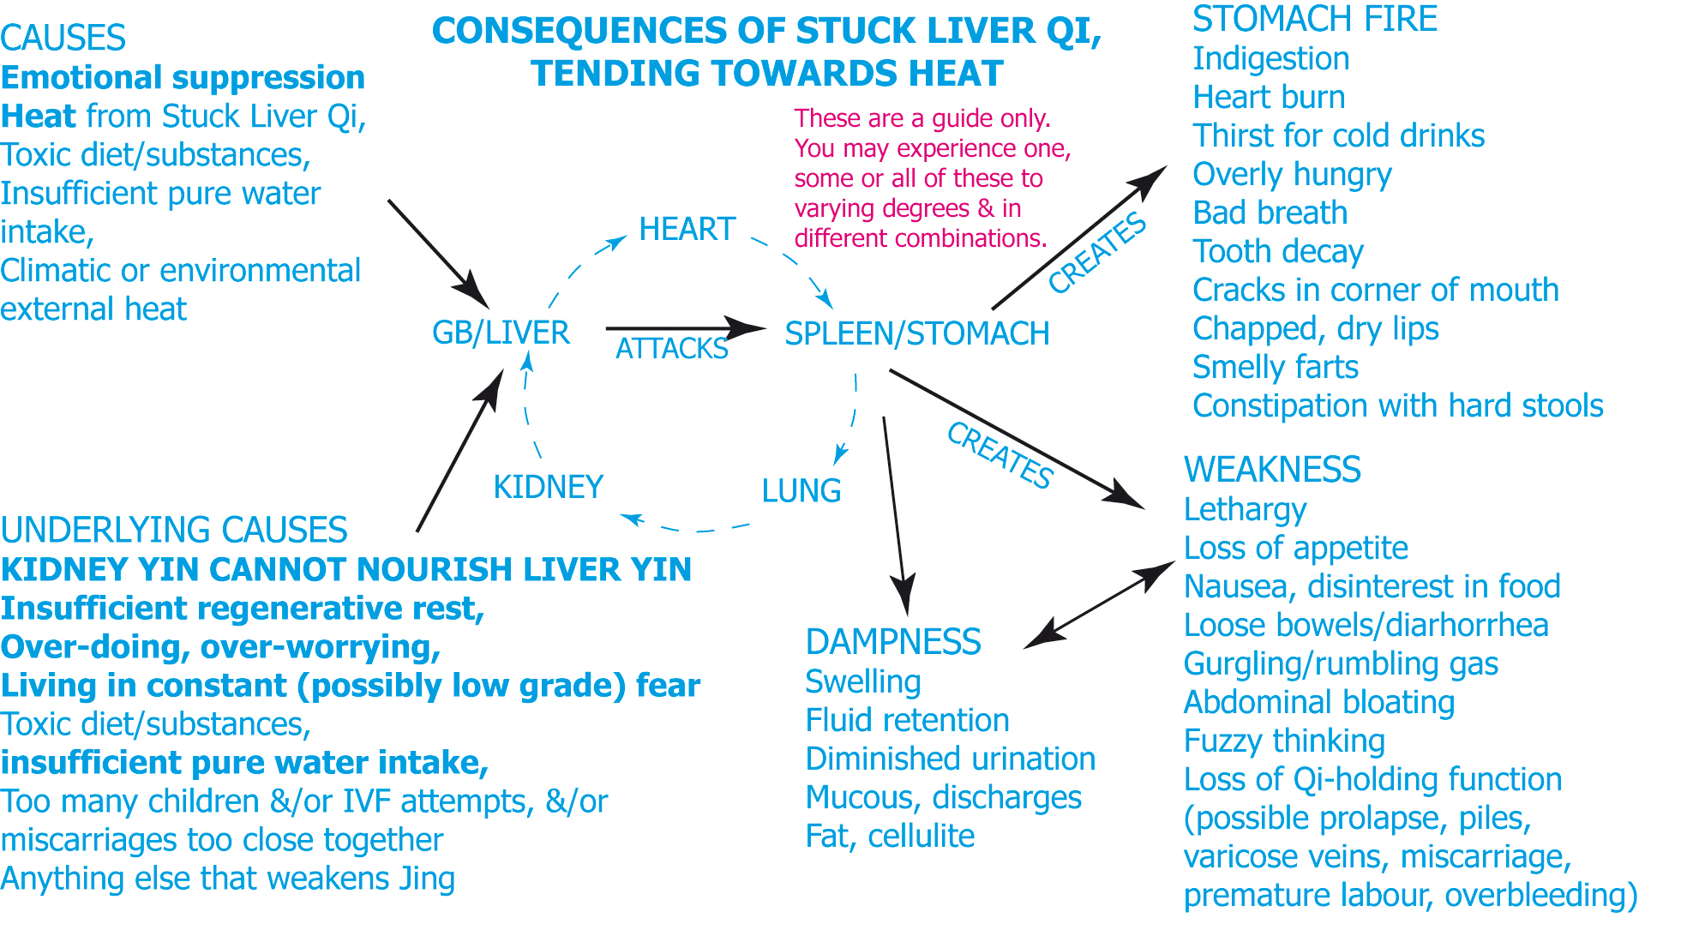
Turning to Heat

Slide 35
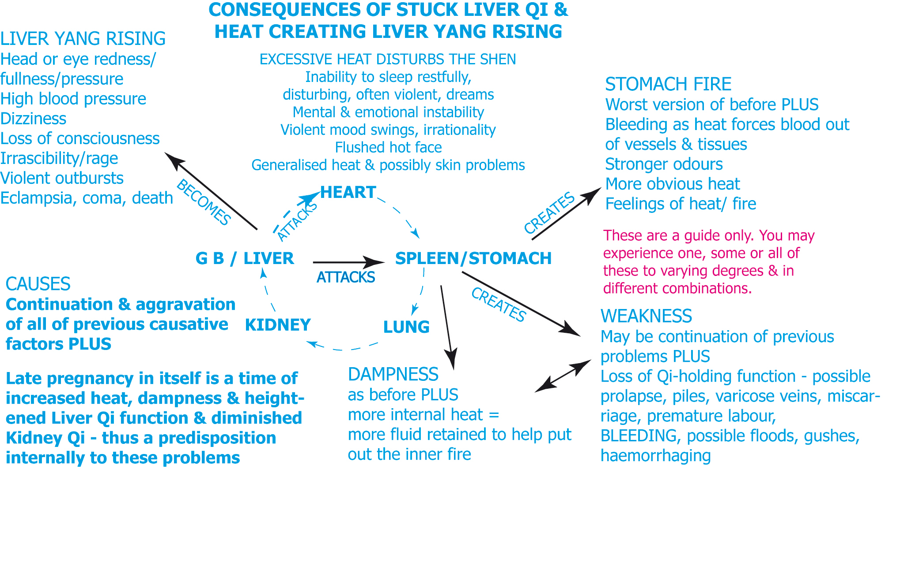
Then to Yang Rising . .

Slide 36
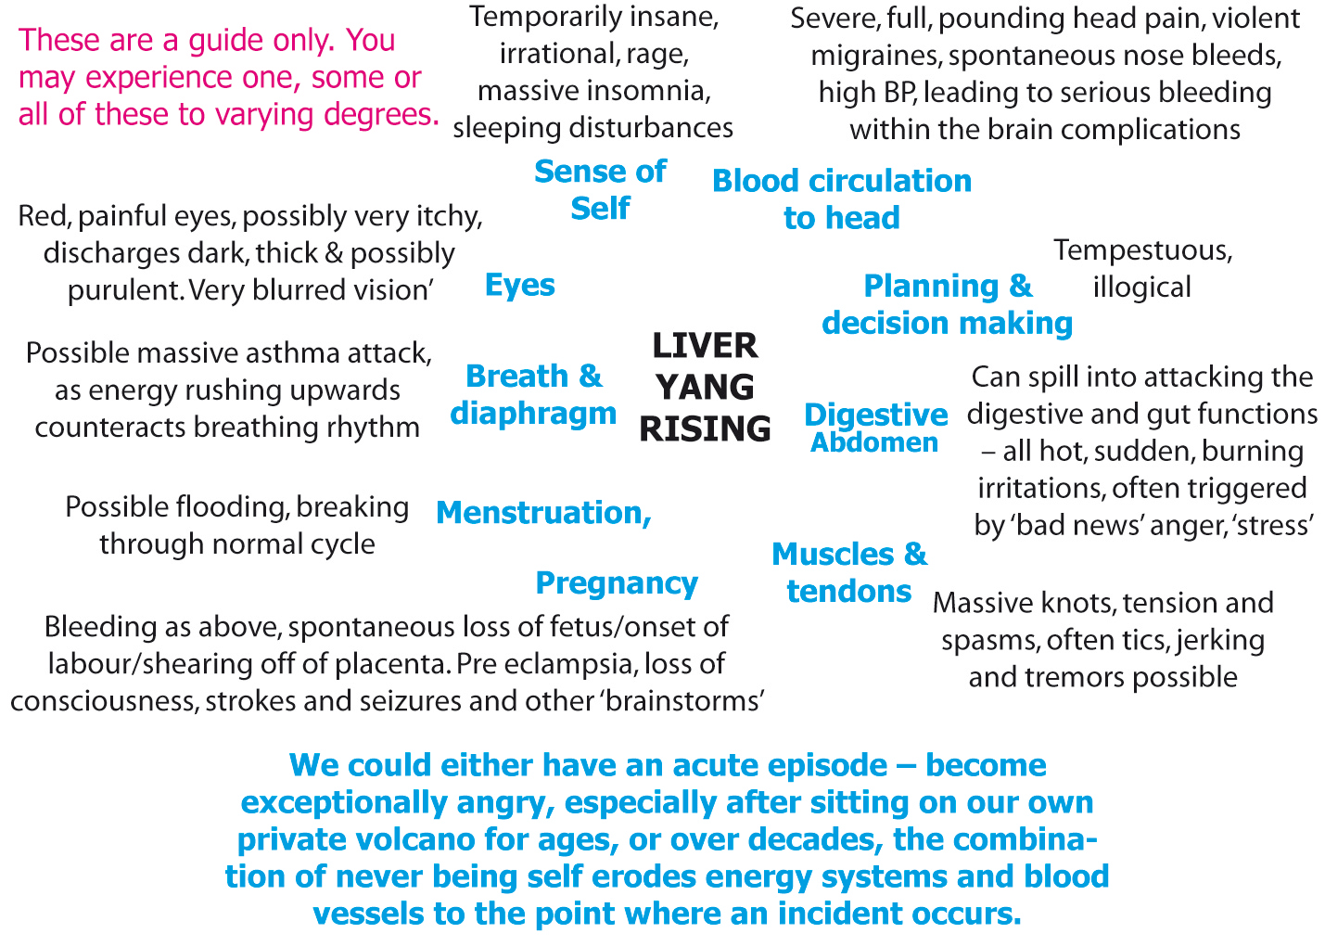
Can go to - Liver Yang Rising

Slide 37
&/or - Deficiency of Blood

Slide 38
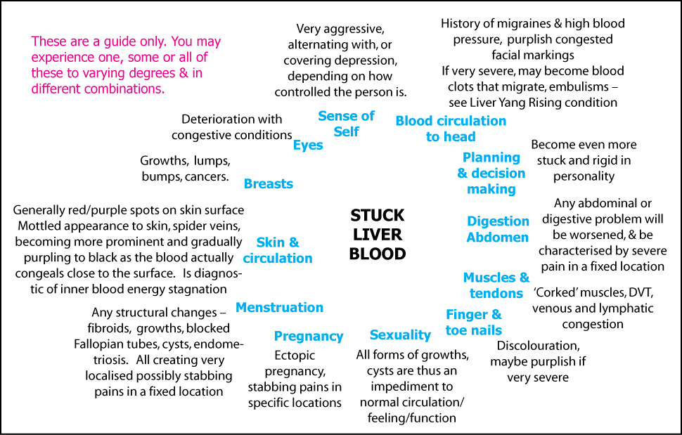
&/or Stuck Liver Blood

Slide 39
Integrating with physiology
In times past all knew automatically what to eat, and when as we were more tied to the seasons in their gardens, and cause and effect was immediately obvious.
Most must study considerable Western biomedical information, as part of their traditional medical courses, & updates are freely available online

Slide 40
Healthy metabolism
Essentials of life
Clean air, water & soil alive with micro organisms and also ‘clean’ – no toxic residues in any of these basics – leading onto pure food sources.
Soil able to supply the nutrients for the plants to then be part of our food chain.

Slide 41
No toxic residues in human tissues
Harder as we move through the decades with the modern chemical factories etc spewing out all (Fukishima as an example)
Micro environments – injecting toxins as ‘beneficial’ without due diligence in science – no RCT or EBM for vaccination now leaving all with heavy metals impacting very heavily on their essential nutrient pathways, & with DNA junk from other species to contend with.

Slide 42
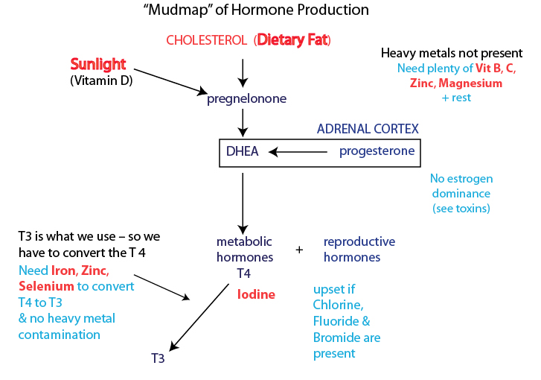
What we know from physiology

Slide 43
What we need to live well
Fat
Sunlight
Animal proteins/organs/fats
Mineral rich foods and water
Freedom from whatever gets in the way of nutrient pathways & nutrient assimilation
Sleep, rest, safety, security, inclusion in our tribe for overall wellbeing & sense of purpose

Slide 44
In times past . . .
Lived on the land, in time with seasons
Grew own food, or worked a lot outside
Traveled by foot, physically active
Slept with the sun’s cycles
Ate simply and drank water
Few chemicals/toxins as all knew the cause and effect and moved away from wells/soils that were dangerous

Slide 45
All cultures had ‘sacred’ foods
For the youth, the precious ones who would bring forth new members of the tribe – as well as they could be made.
Animal organs, fats and other delicacies – esp from the sea.
Fat a crucial part of all diets as was essential proteins.
See more in Weston Price’s work

Slide 46
Pottenger’s cats
Easily discovered – what we feed our adults affects what their babies are made from and how they are healthy – or not.
Discovered after 3 generations of eating rubbish food (cooked and with sugar) – there was no 4th generation
Where are we now in the modern food environments? (Chemicals/GMO?)

Slide 47
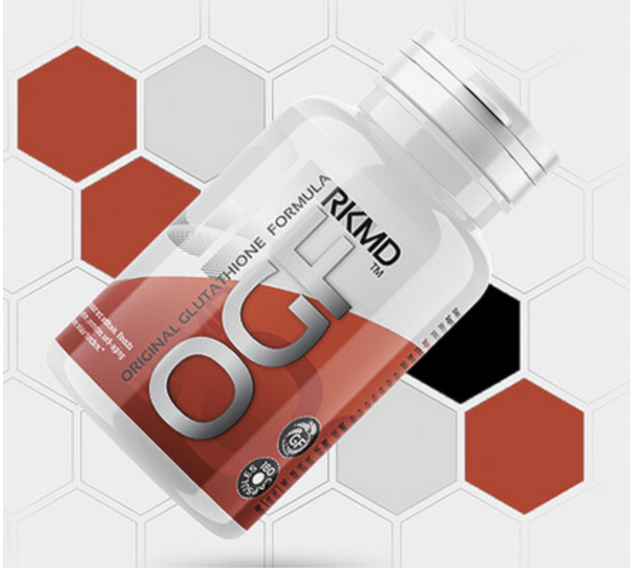
Glutathione accelerator
This product WORKS.
Take 6 capsules daily. Whereas the glutathione itself is useless orally, as it is broken down to its component 3 molecules.

Slide 48
Magnesium
Needed for life – over 300 enyzmatic activities (mitochondrial action)
Liken it to Qi – Yang
Needed for cardiac and all electrical impulses
Calcium/magnesium balance/see-saw
Kept rigidly at 1% in blood stream
(Cardiac dramas follow if not stable there)

Slide 49
Major component of Glutathione
Needed for detoxing through out the body.
Best as always was – in greens and whole foods.
Where are they in a modern diet?
Also used on skin – as it absorbs very easily (Transdermally)

Slide 50
Magnesium deficiency shows as
body aches, ‘growing pains’, leg cramps, jumpy/restless legs, all aches & pains, tremors, fatigue or low energy, restless sleep, headaches and migraines, muscle twitches, chronic constipation, insulin resistance, epilepsy, PMS, hypertension, heart disease, stroke, type 2 diabetes, osteoporosis, high blood pressure, all pain esp cardiac & ongoing structural spasms

Slide 51
Adrenal fatigue/exhaustion – western medicine
Magnesium is needed for all mitochondrial activity. Qi?
Iodine is needed to allow the metabolism to function – bound as it is in the thyroid hormone.
Selenium needed to convert T4 to T3

Slide 52
Adrenal fatigue/exhaustion - TCM

Slide 53
Leading to regeneration less likely

Slide 54
Iodine
Essential ingredient of thyroid hormone
Role of thyroid?
Governs the speed at which the body runs
(Yin/Yang balance?)
Too fast – hyperthyroidism – yin deficiency
Too slow – hypothyroidism – yang def.
Iodine – found in seaweeds, sea foods, sea salt

Slide 55
In times past . .
People just knew
‘Old wives tales’
‘Always did it this way’
Food was essential as was all the ways the elders remembered to do live and pass on aspects of life
Traditional medicine was part of this heritage

Slide 56
Science
‘New kid’ on the scene
Untested
Arrogant, brash, loud, takes over
No test of time, unlike all traditional diets, lifestyles and medical lineages
May not have the answers to solve the problems it has created by throwing out what was working just fine before

Slide 57
Patient education/empowerment
We can offer both – the science of what could be and what was with the ways to enhance living with nature
Not forcing, but allowing the body to heal through good nutrition, and balanced life habits
Through whatever traditional medicine was are using as wall respected the body and the environment it lived in

Slide 58
Further sources (Magnesium)
www.mgwater.com (can download ‘The Pathogenesis of Disease’ Mildred Seelig
The Magnesium Factor - Seelig/Rosanoff
Transdermal magnesium http://drsircus.com/medicine/magnesium/
Dr Carolyn Dean http://drcarolyndean.com/magnesium_miracle/

